Slide 1

Web Proxy
Huang Hao, Zhou Yitong, Meng Yu, Chen Zijie, Wen Tianshu
2024.11.29

Slide 2
CONTENTS
Introduction of web proxy
01 Introduction
Divide of tasks
02 client & server
CONTENTS
03 proxy
04 Test
05 Conclusion

Slide 3
01
PART
Introduction

Slide 4






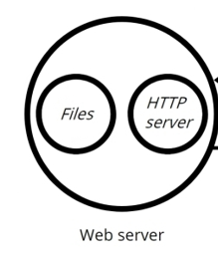
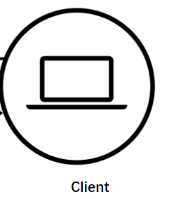
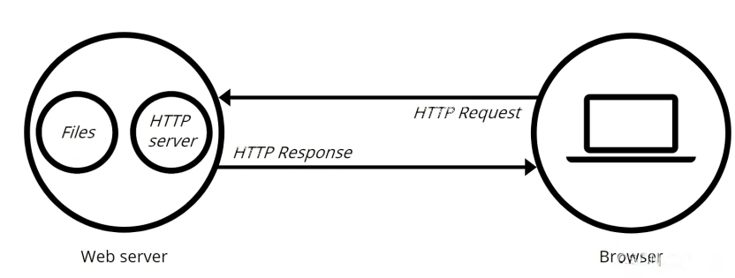


Prepare
client&server
proxy
test
conclusion
Web Proxy working flow
Request
Request
Web proxy
Web proxy
Web Proxy
Web Server
Response
Response
Client
The client can talk with the proxy, and then the proxy communicates with the server on behalf of the client.

Slide 5
Prepare
client&server
proxy
test
conclusion
Why we use web proxy
Request
Request
Web proxy
Response
Response
Advantage:
Access control
Access Restrictions : Only allow to access the whitelist sites.
Firewall : Form a firewall to ensure network security.
Improving efficiency
Web Caching :The next visit directly, faster.
Reverse Proxy : Proxy acts as a server to obtain content from other servers, efficient and fast
Privacy protection
Identity Hiding : Hide user identity information.

Slide 6
Prepare
client&server
proxy
test
conclusion
Division of tasks
Huang Hao(presentor)
Getting through the code framework
UI design
testing
Wen Tianshu
server design
client design
Zhou Yitong
Task framework design
proxy design
Chen Zijie
concurrent control
client design
Meng Yu
proxy design
Functional testing

Slide 7
02
PART
client & server

Slide 8


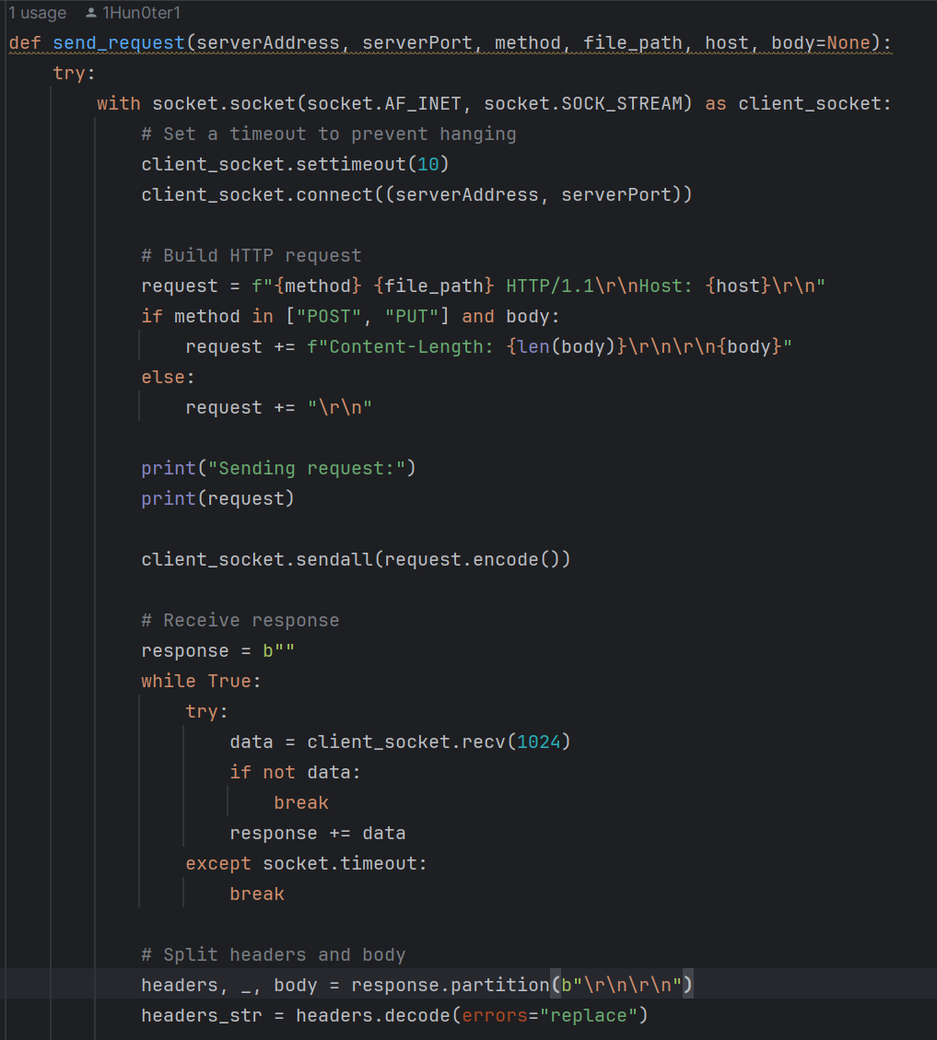
Prepare
client&server
proxy
test
conclusion
Client
1. Set the socket
2. Connect to the proxy
3. Build HTTP request
4. Send to proxy
5. Receive from proxy
6. Decode the response

Slide 9
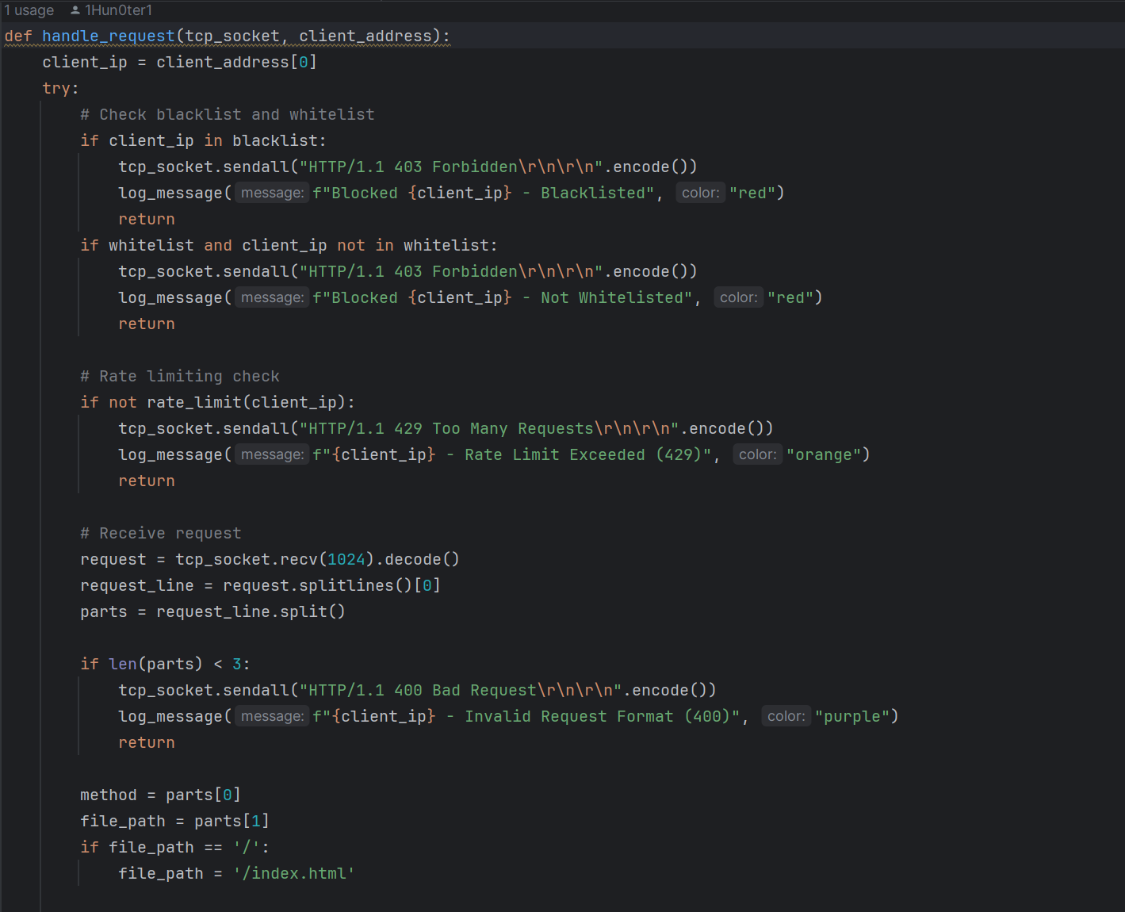
Prepare
client&server
proxy
test
conclusion
Server
1.* Safety set
2.* Rate control
3. Decode the request from proxy

Slide 10
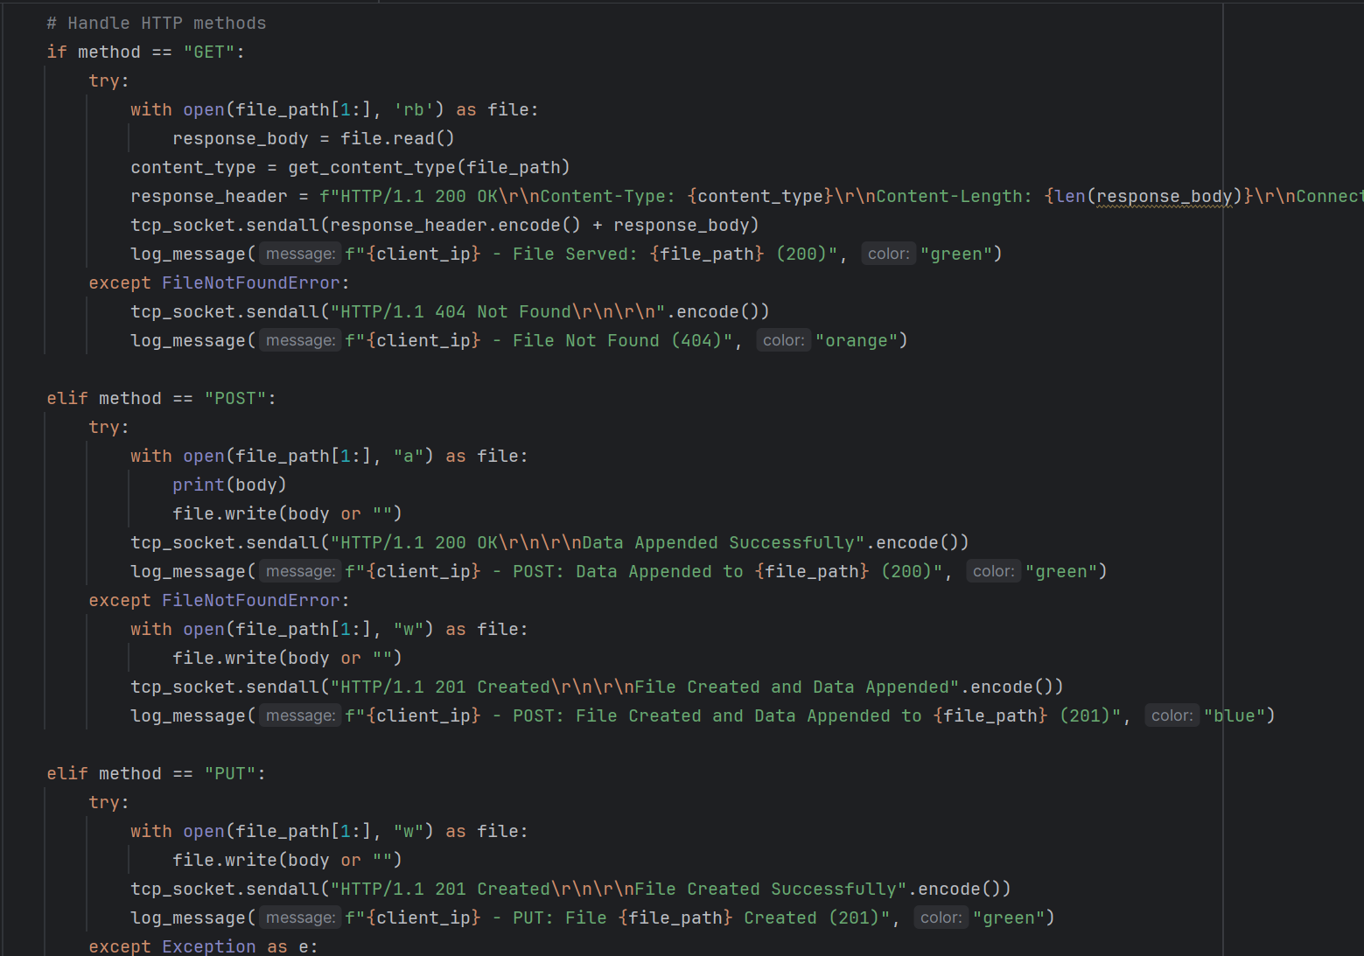
Prepare
client&server
proxy
test
conclusion
Tackle with different methods
1. GET
2.* POST
3.* PUT

Slide 11
03
PART
proxy

Slide 12





Prepare
client&server
proxy
test
conclusion
Summary of Key Logic
Response
Web proxy
Response
Request
Request
Request
Response
local
cache

Slide 13
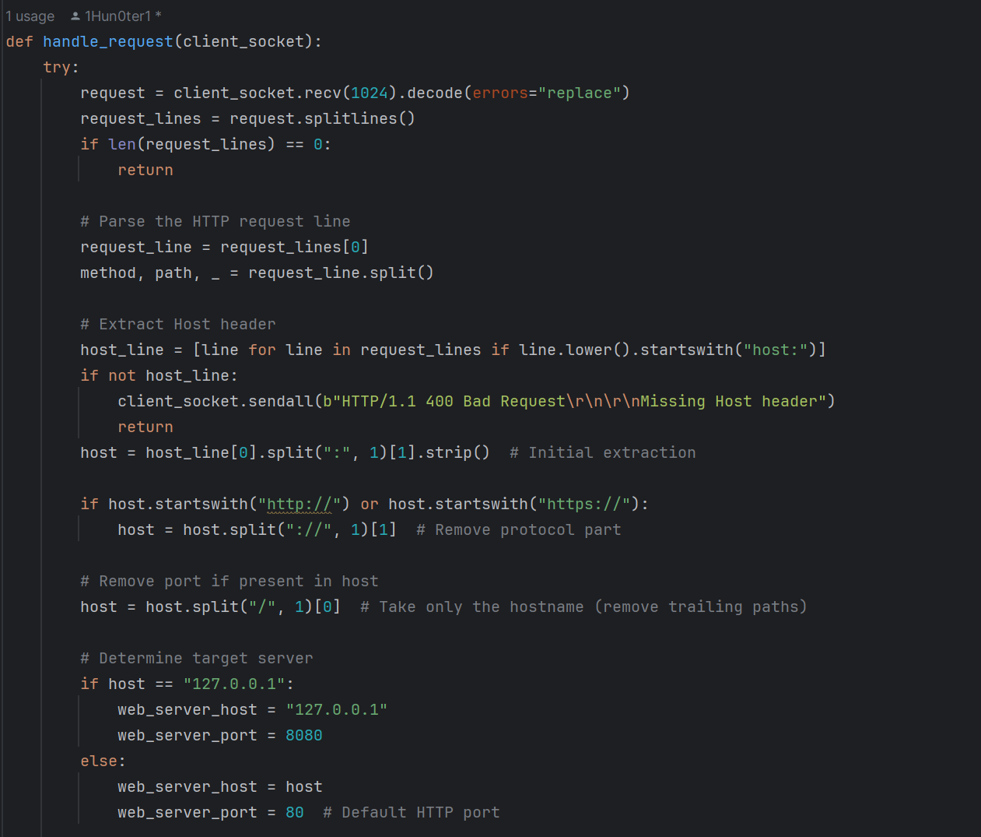
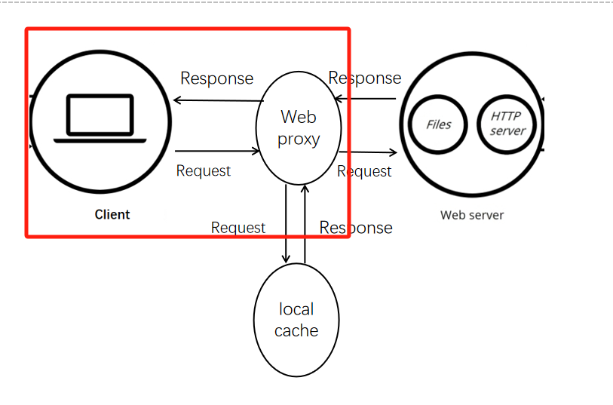
Prepare
client&server
proxy
test
conclusion
Act as client & server
Fetch from client & Send to client

Slide 14
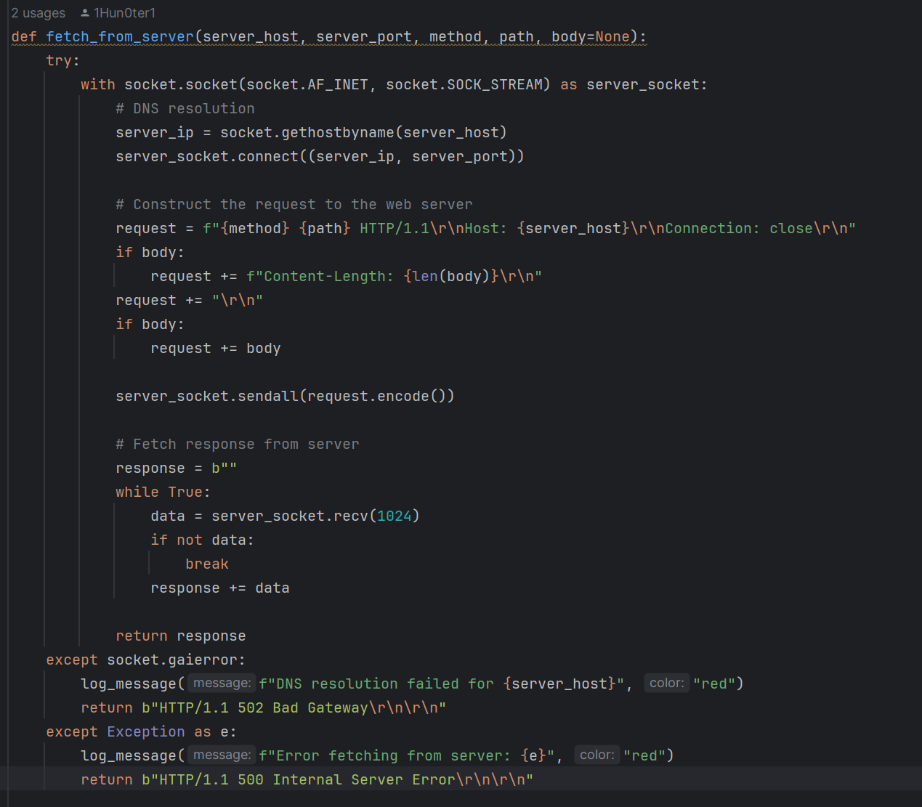
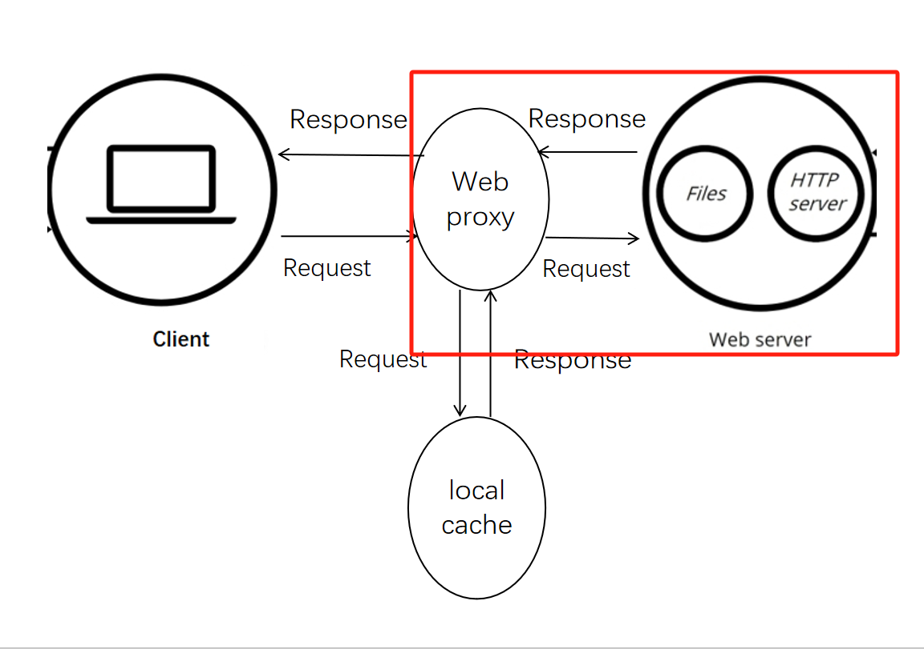
Prepare
client&server
proxy
test
conclusion
Act as client & server
Sent to server & Fetch from server

Slide 15
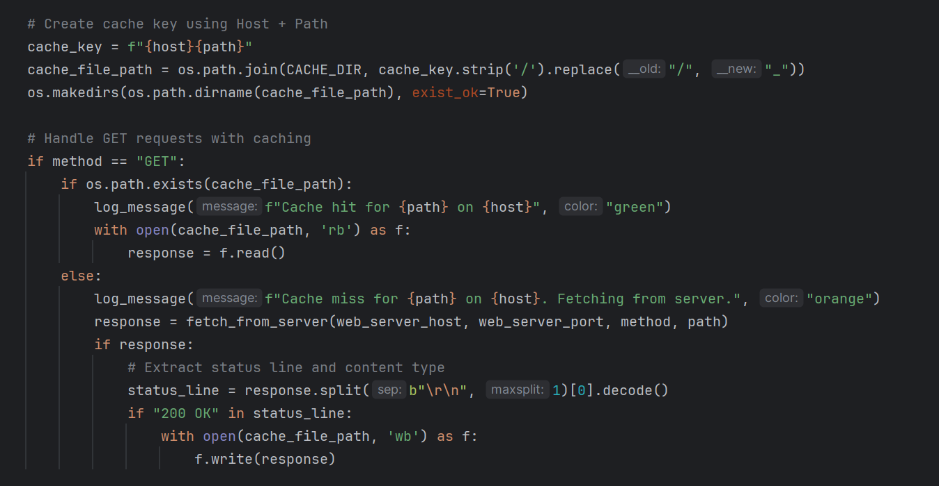
Prepare
client&server
proxy
test
conclusion
Cache design
Object url: host + path
Cache hit
Cache miss
&
write to cache

Slide 16
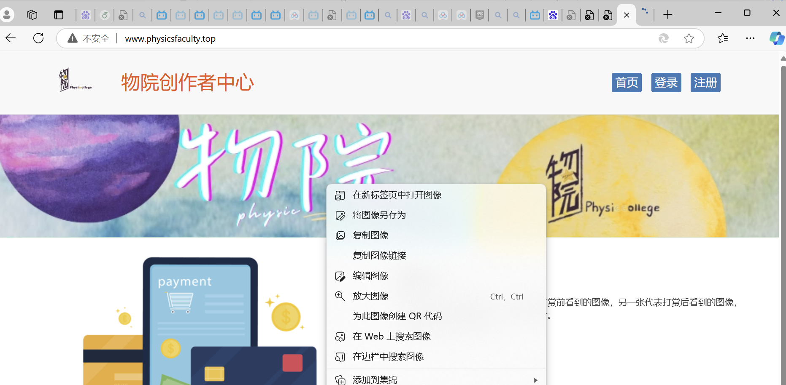
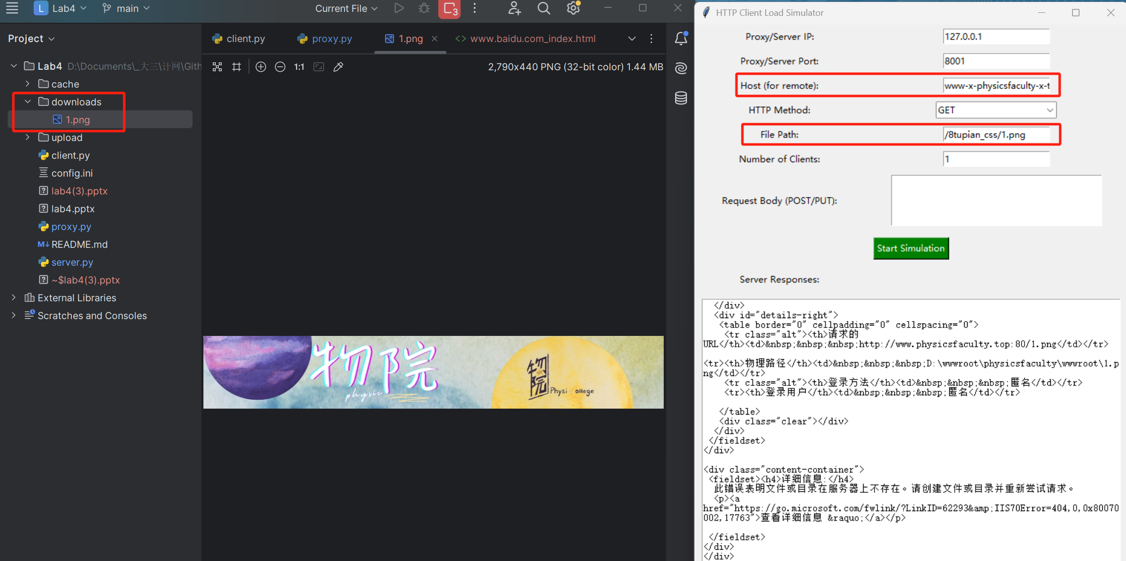

Prepare
client&server
proxy
test
conclusion
Crawl photos in our own website

Slide 17
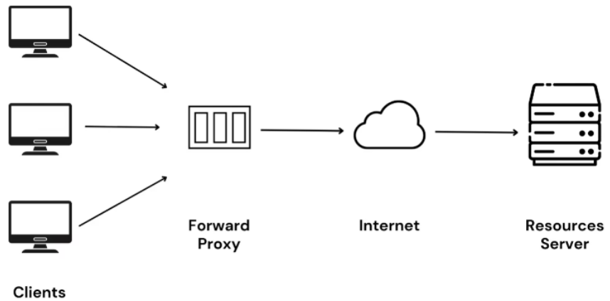
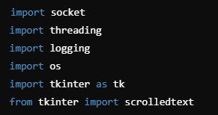
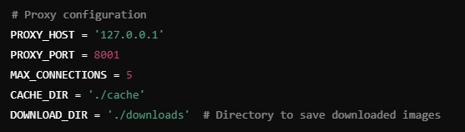
Prepare
client&server
proxy
test
conclusion
Imports and Configuration & Logging Setup
The code begins by importing the necessary libraries:
socket: For creating the proxy server and handling network connections.
threading: To handle multiple client requests concurrently using threads.
logging: For logging messages and errors.
os: For handling file paths and creating directories.
tkinter: To create a GUI for managing the proxy server.
scrolledtext: For displaying logs in a scrollable area in the GUI.
Then, several configuration parameters are defined:
PROXY_HOST and PROXY_PORT: These set the IP address and port for the proxy server. By default, it listens on 127.0.0.1:8001.
MAX_CONNECTIONS: Limits the number of concurrent client connections to the proxy server (set to 5).
CACHE_DIR and DOWNLOAD_DIR: Directories for caching and saving downloaded images. Images will be stored in the downloads folder.
Next, we configure logging:
This sets up the logging system to display log messages with timestamps. It will log messages at the INFO level and higher.

Slide 18
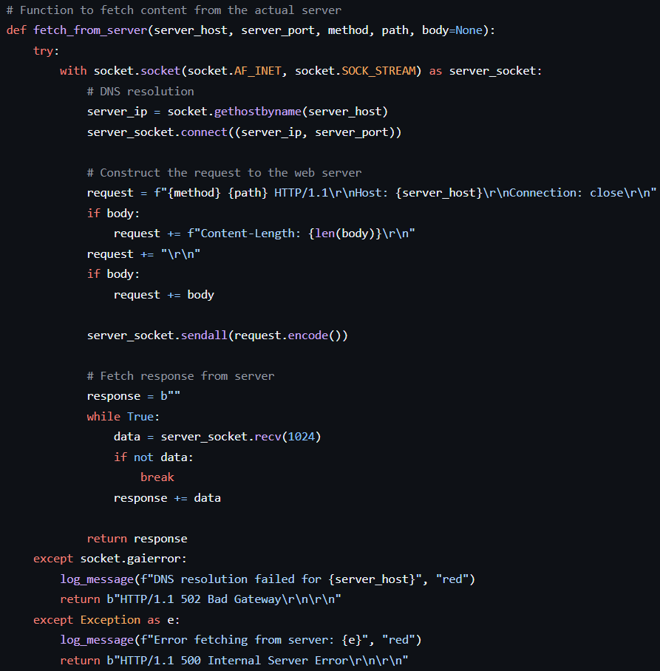
Prepare
client&server
proxy
test
conclusion
Fetching Content from the Actual Server
The function fetch_from_server handles the communication with the actual web server (which the proxy forwards the client requests to):
Socket creation:
A socket is created using socket.AF_INET (IPv4) and socket.SOCK_STREAM (TCP).
DNS resolution:
socket.gethostbyname is used to resolve the server's IP address.
Request construction:
The function constructs an HTTP request (e.g., GET /path HTTP/1.1) and sends it to the web server.
Response handling:
The server’s response is received in chunks and stored in the response variable.
Error handling:
If DNS resolution or any other error occurs, the function logs the error and returns a 502 or 500 HTTP error response.

Slide 19
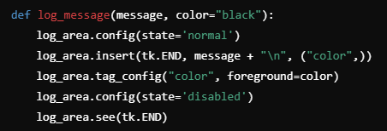
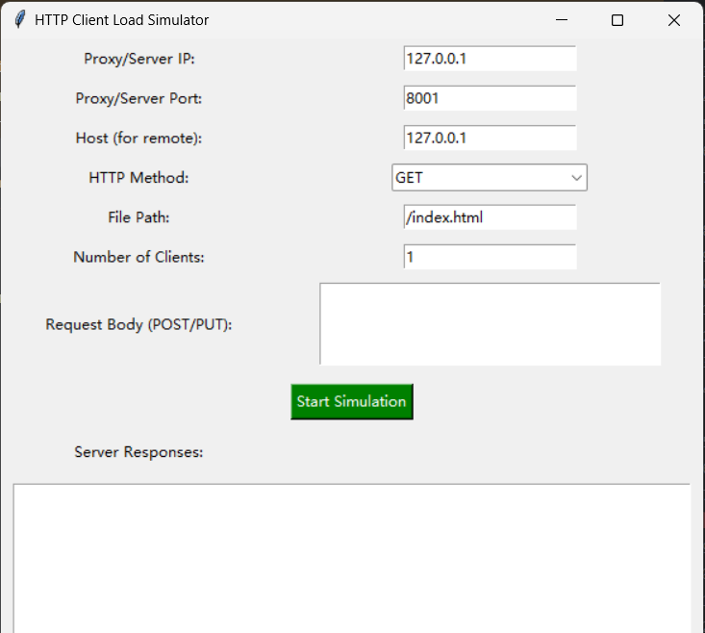
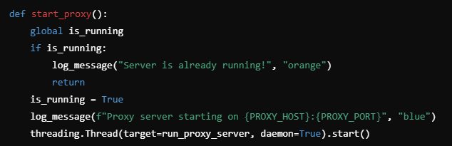
Prepare
client&server
proxy
test
conclusion
GUI Functions
The log_message function displays log messages in the GUI:
GUI Log:
This function inserts messages into the scrollable text area (log_area) with optional color formatting.
Starting and Stopping the Proxy Server:
The start_proxy function starts the proxy server, and stop_proxy stops it.
Start the server:
If the server is not already running, it starts a new thread that runs the run_proxy_server function.

Slide 20
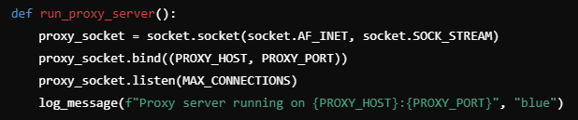
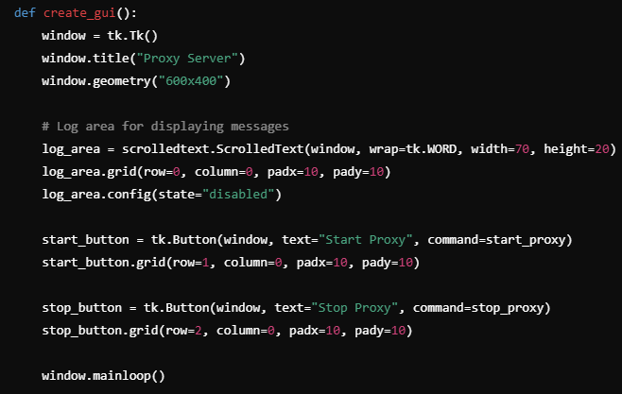
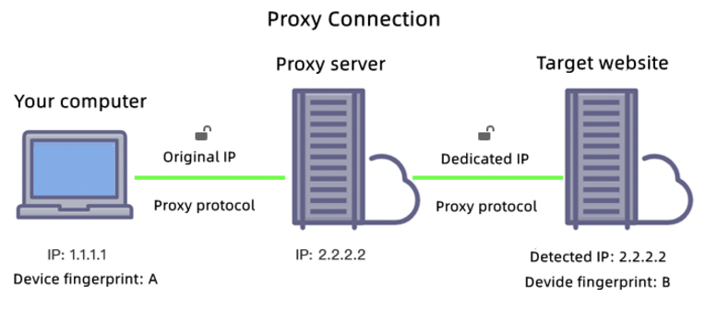
Prepare
client&server
proxy
test
conclusion
Running the Proxy Server & Tkinter GUI Setup
Socket creation and listening:
A socket is created, bound to the proxy's host and port, and set to listen for incoming connections.
Accepting client connections:
When a client connects, a new thread is created to handle the client’s request using the handle_request function.
GUI Setup:
A basic tkinter window is created with buttons to start and stop the proxy server, as well as a log area to display messages.

Slide 21
04
PART
Testing

Slide 22





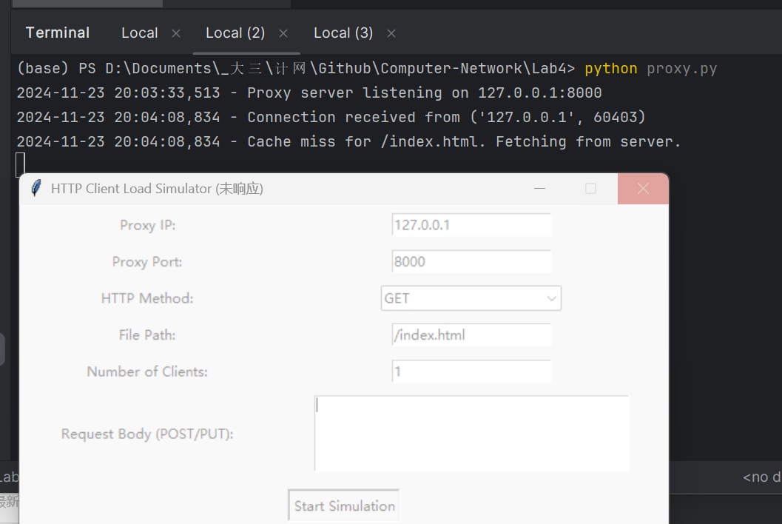
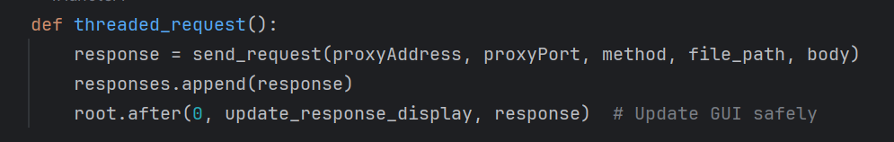
introduction
client
server
test
conclusion
Multiple problems have been solved
1. client.py can’t reply: The main thread is blocked
Possible Solution:
thread.join()
root.after()
Update the response_display asynchronously to ensure that the UI doesn't get stuck with data writes

Slide 23
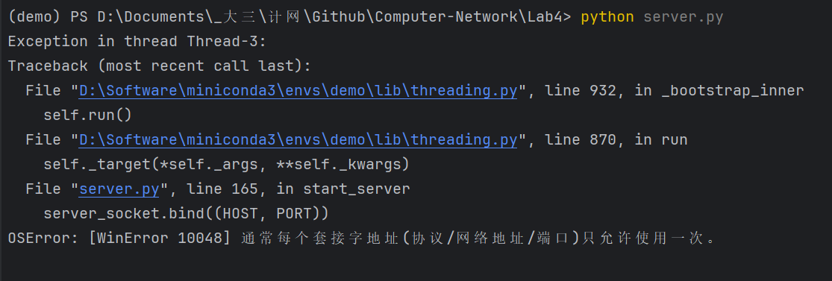
introduction
client
server
test
conclusion
Multiple problems have been solved
2. Socket parameter error:
Possible Solution:
Change the web server or proxy port

Slide 24
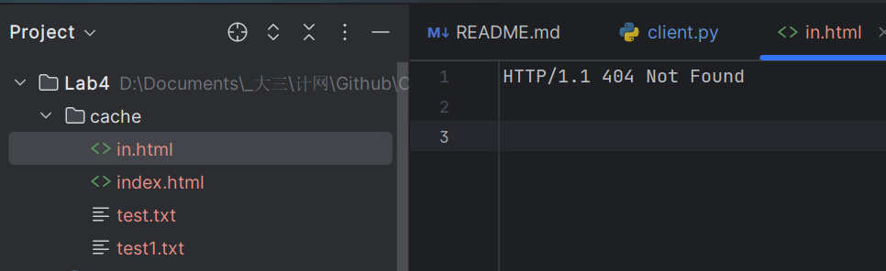
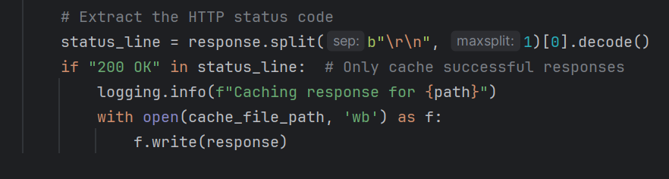
introduction
client
server
test
conclusion
Multiple problems have been solved
3. Unexpected storage in cache:
Possible Solution:
We only want to store the acessable file.
Add a new condition:

Slide 25
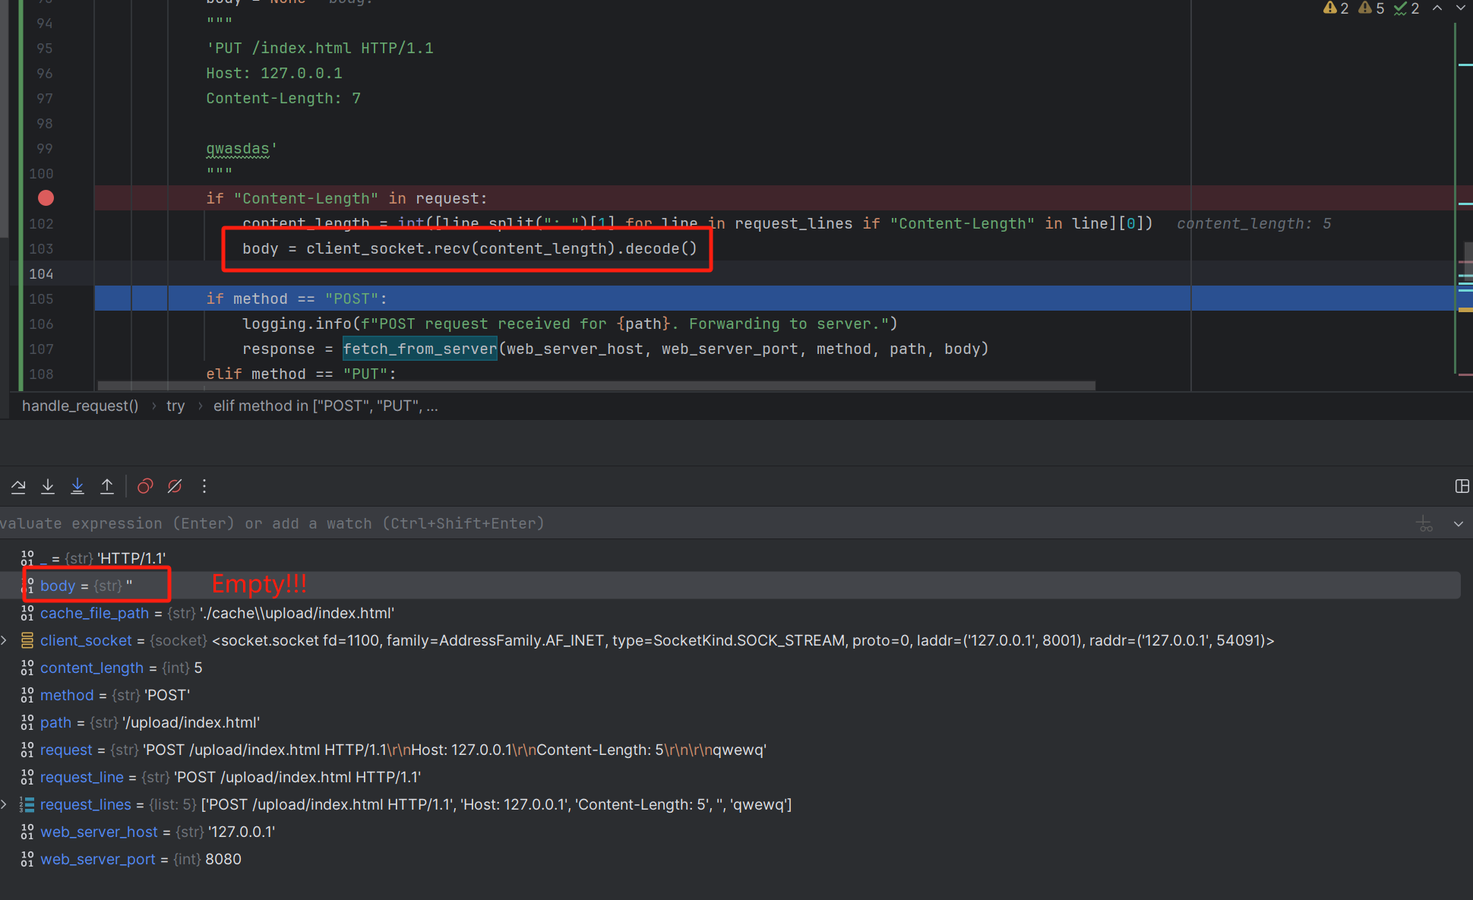
introduction
client
server
test
conclusion
Multiple problems have been solved
4. Post unsccessfully:

Slide 26
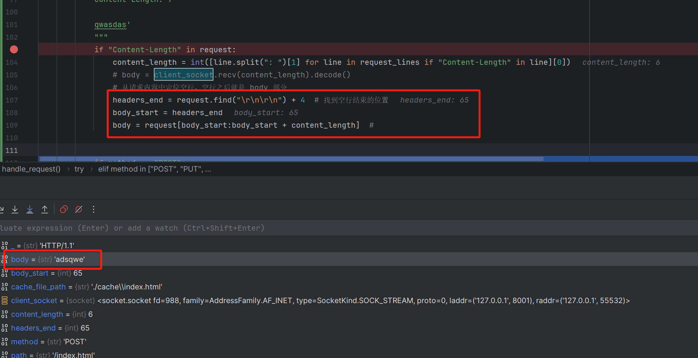
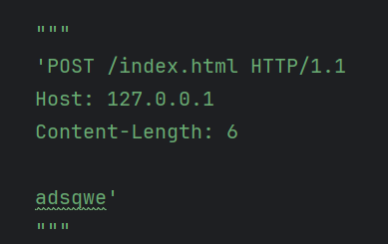
introduction
client
server
test
conclusion
Multiple problems have been solved
4. Post sccessfully:

Slide 27
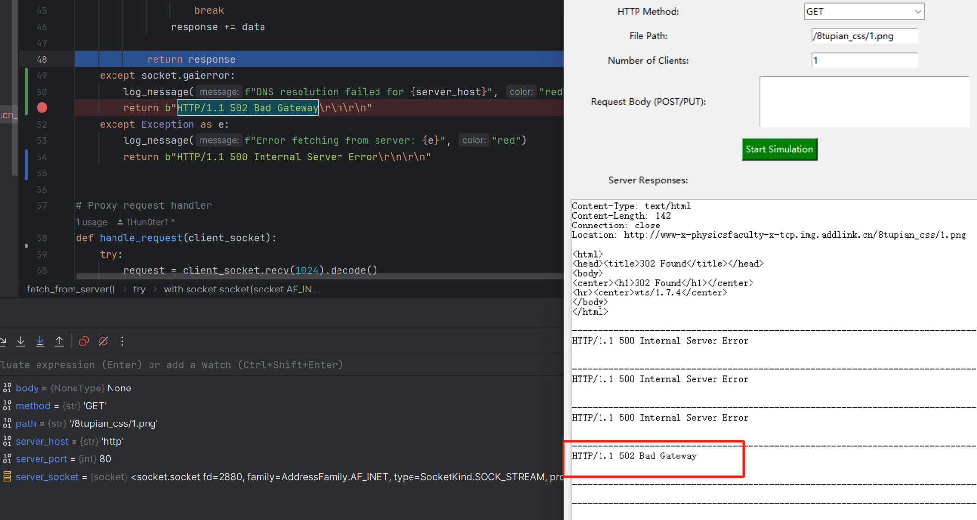
introduction
client
server
test
conclusion
Multiple problems have been solved
5. DNS resolution failed:

Slide 28
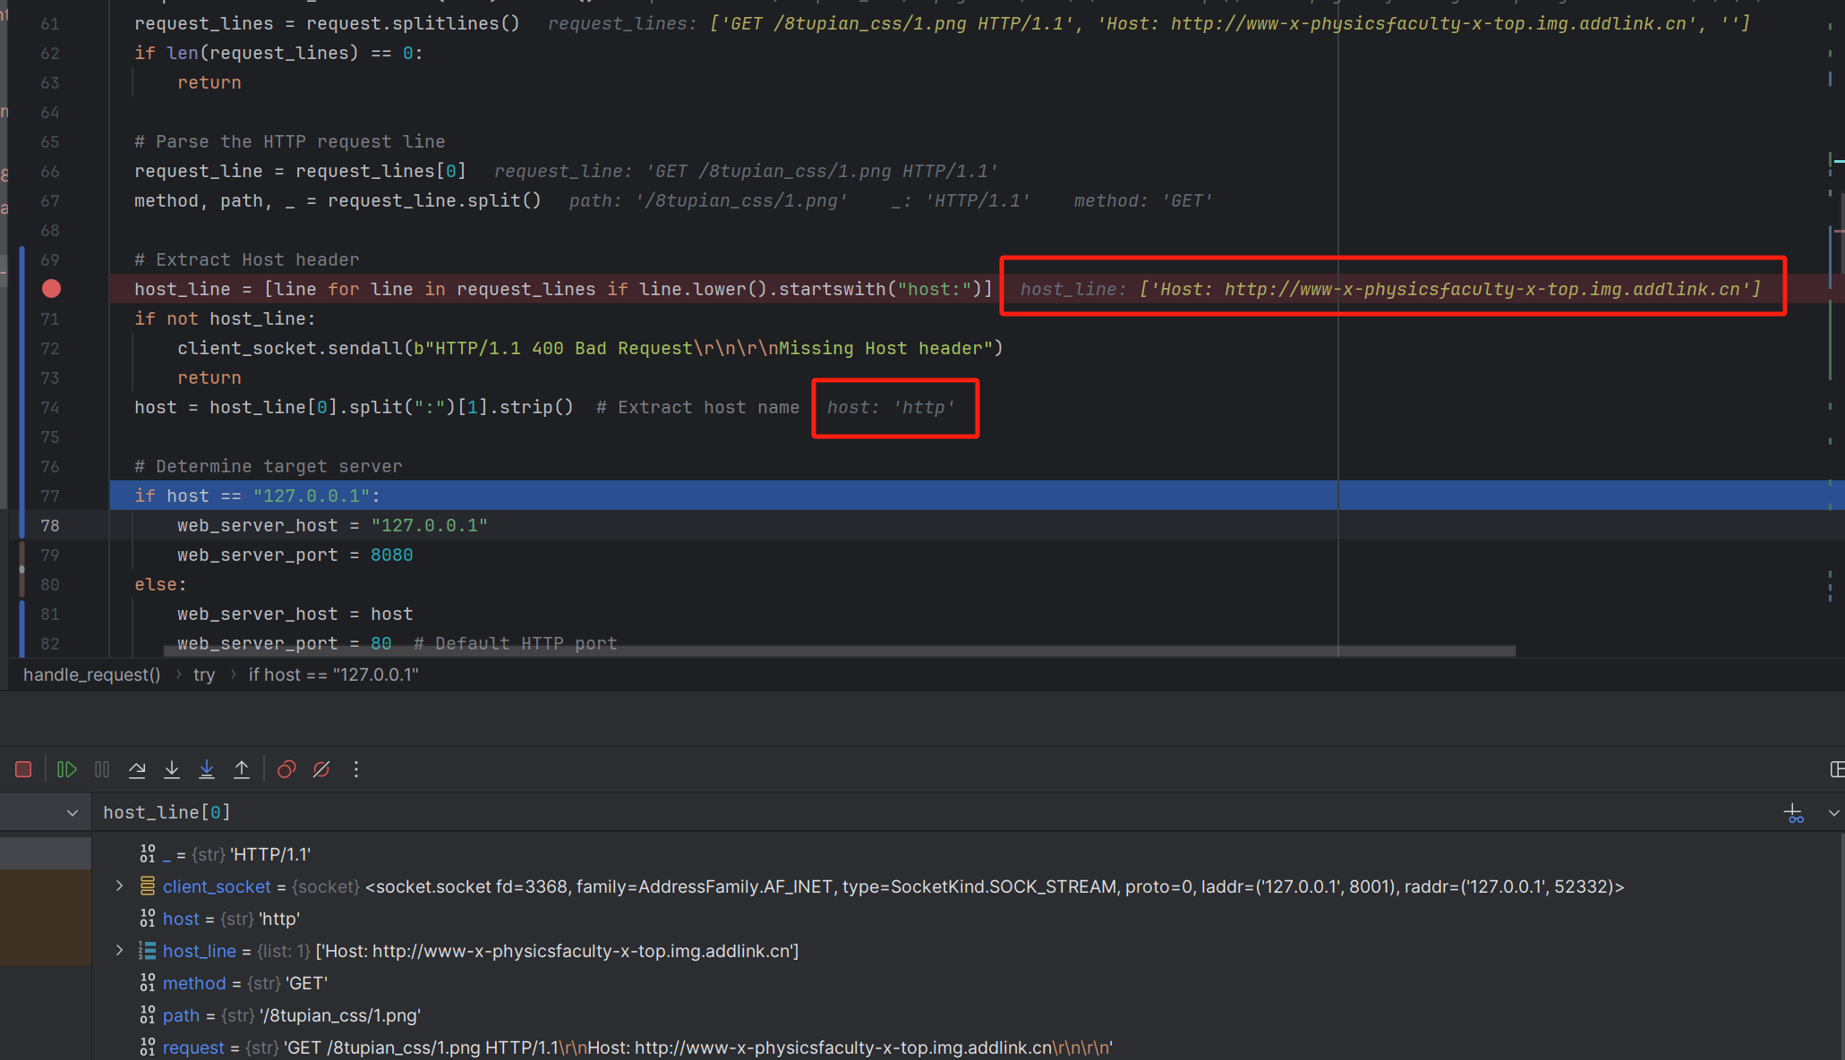
introduction
client
server
test
conclusion
Multiple problems have been solved
5. DNS resolution failed:

Slide 29
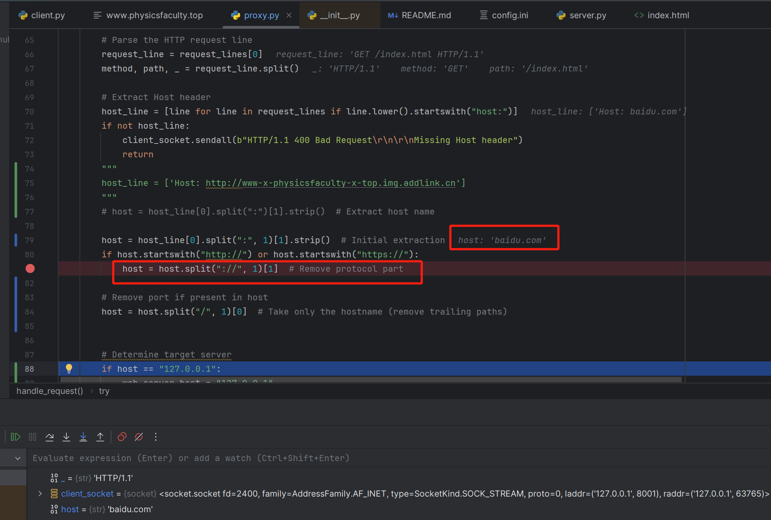
introduction
client
server
test
conclusion
Multiple problems have been solved
5. DNS resolution successfully:

Slide 30
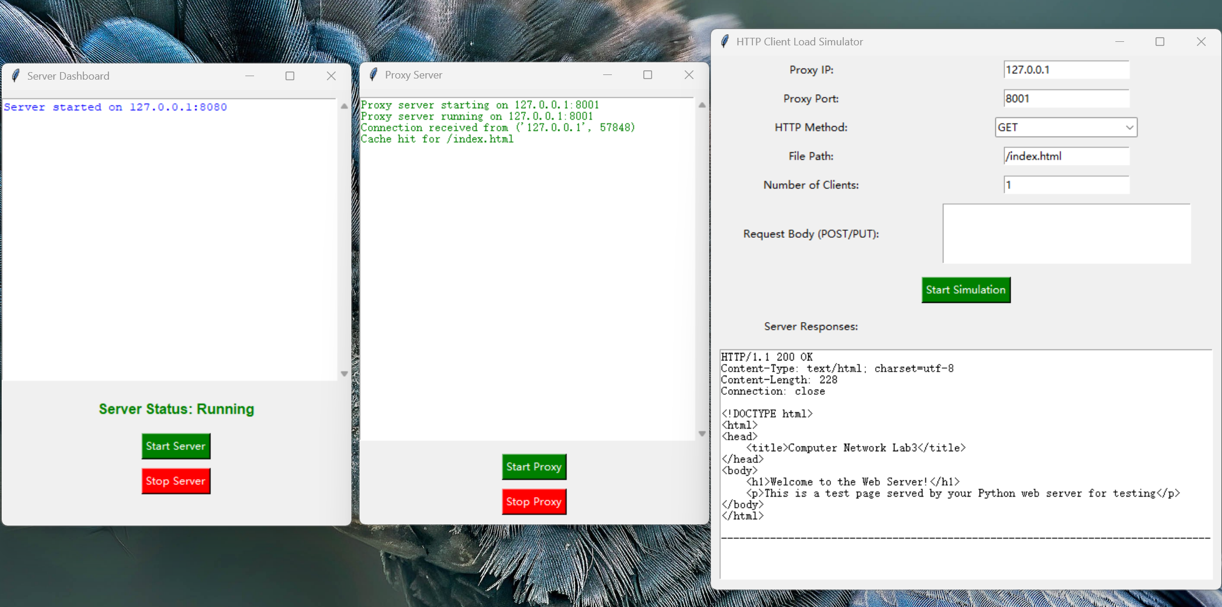
introduction
client
server
test
conclusion
Show the result
get method

Slide 31
05
PART
Conclusion

Slide 32


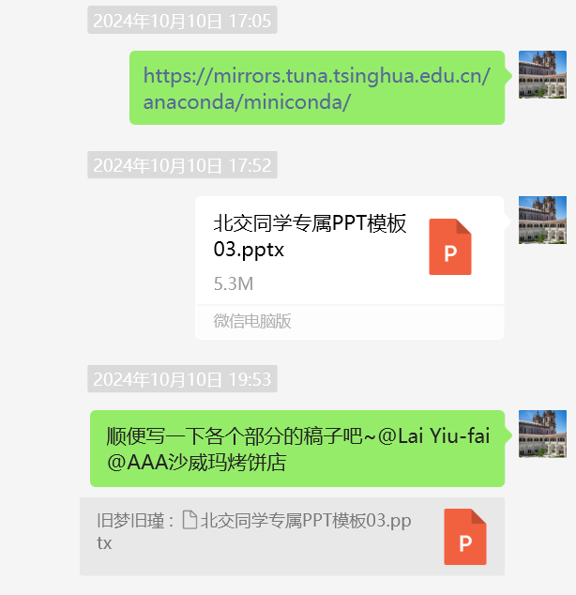
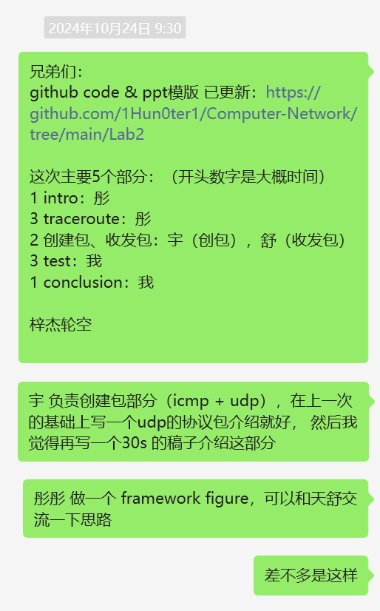
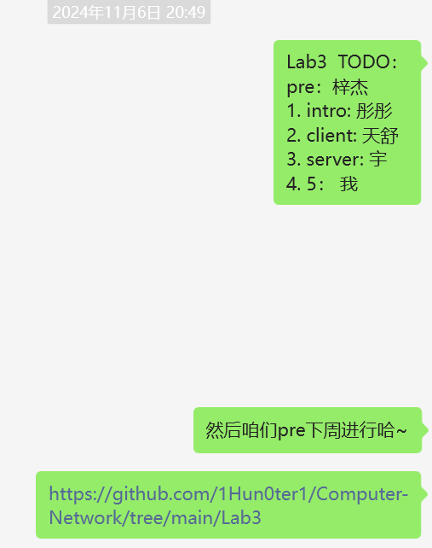
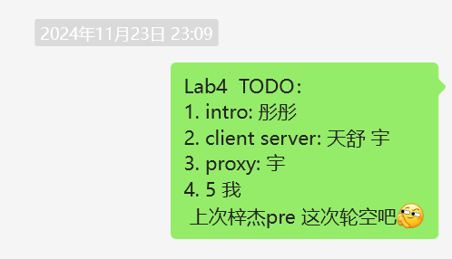
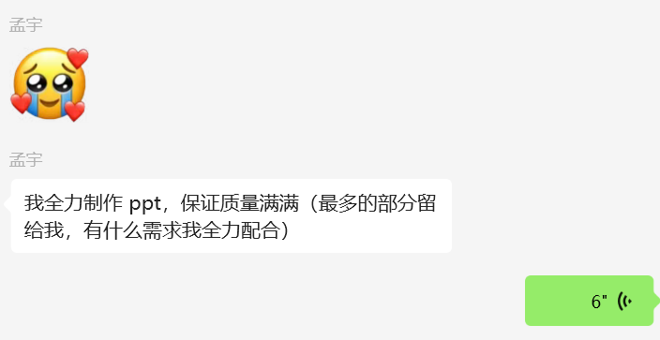
prepare
client
server
test
conclusion
From Lab1 to Lab4
Lab1 ping
Lab2 traceroute
Lab3 web server
Lab4 web proxy

Slide 33
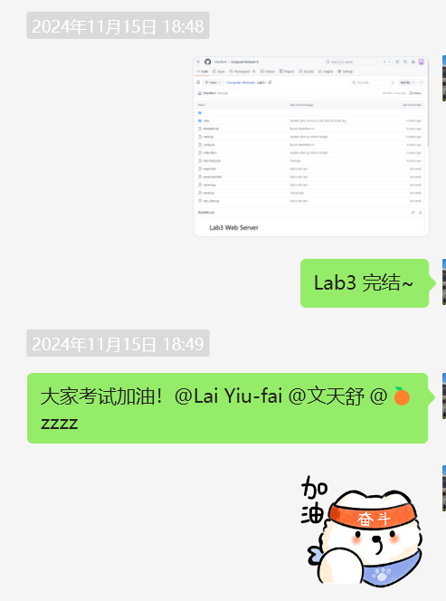
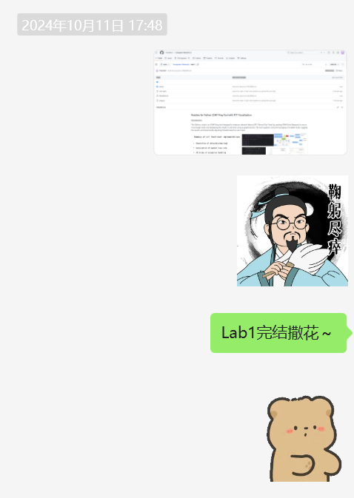
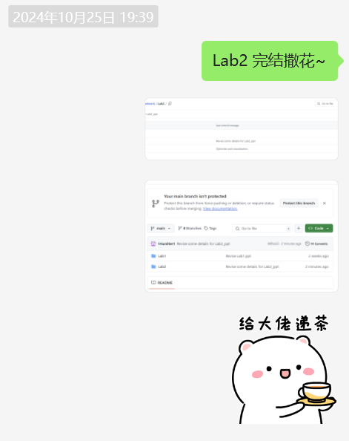
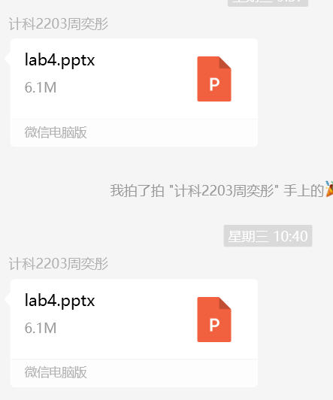
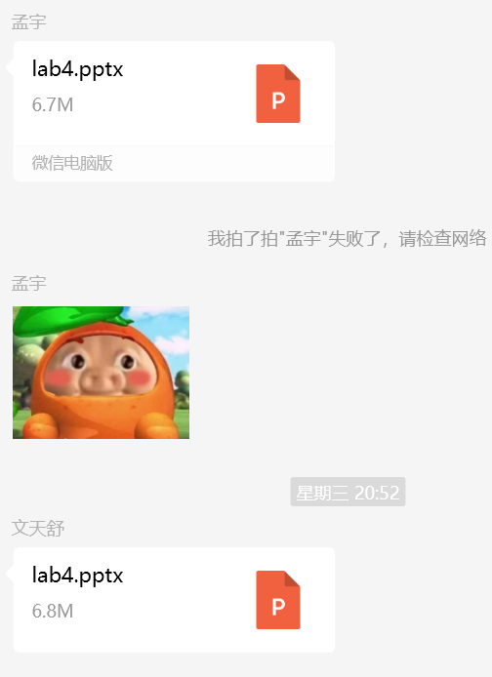
prepare
client
server
test
conclusion
From Lab1 to Lab4
Lab1 ping
Lab2 traceroute
Lab3 web server
Lab4 web proxy

Slide 34
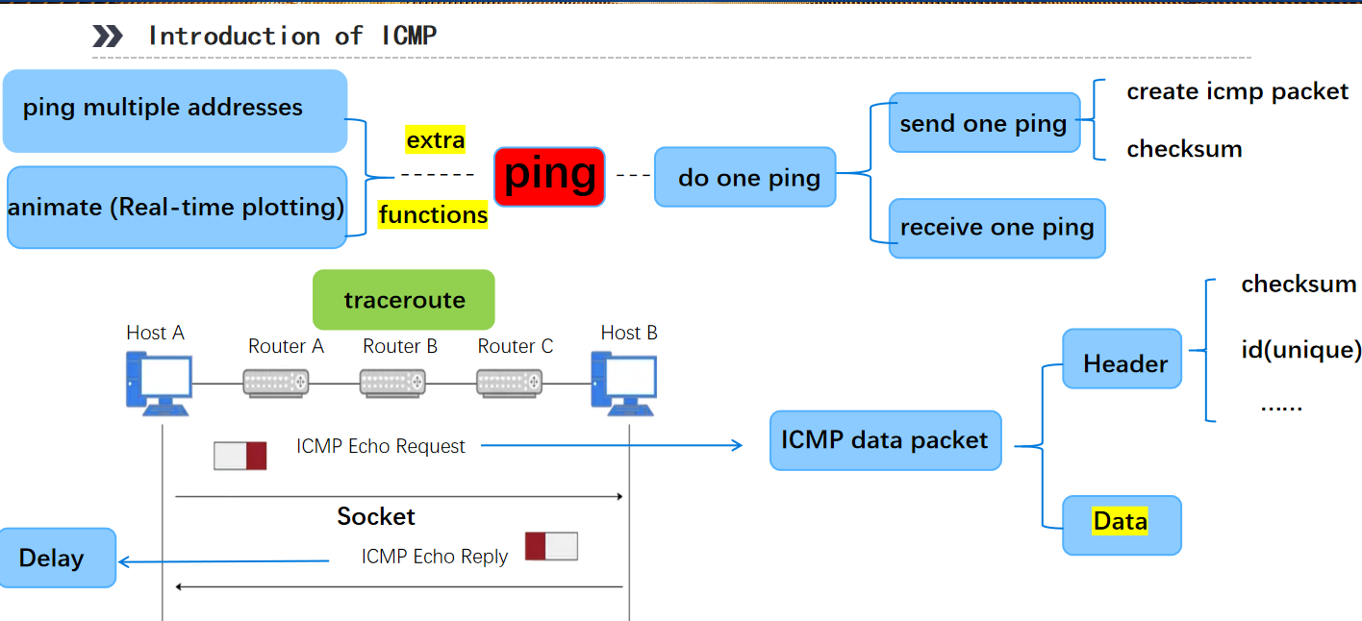
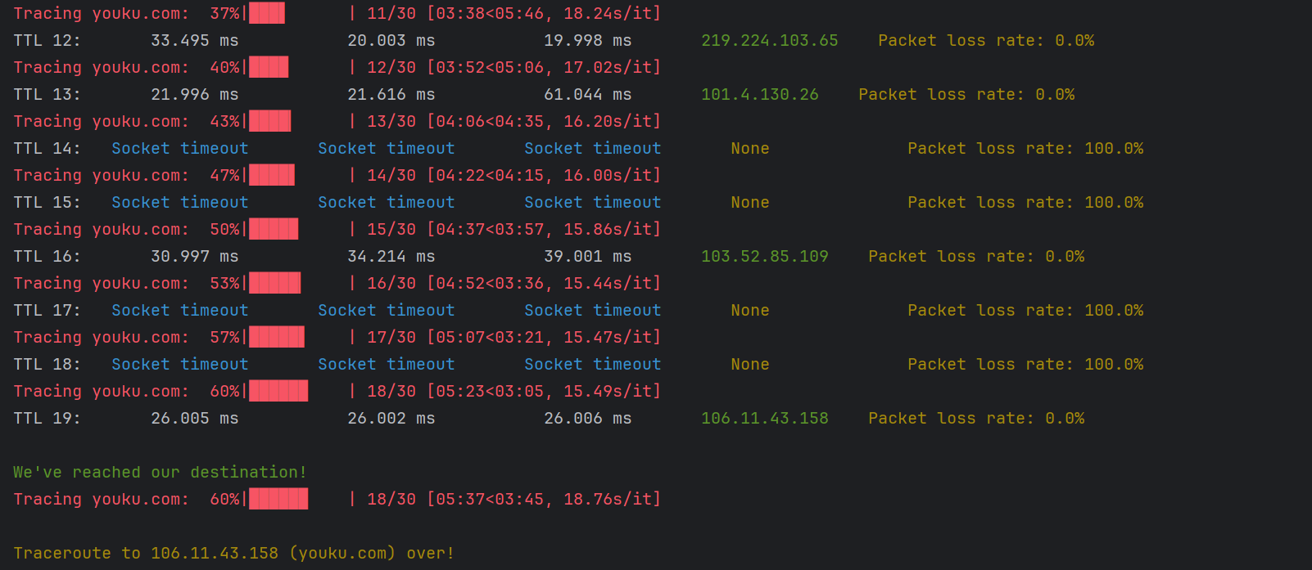
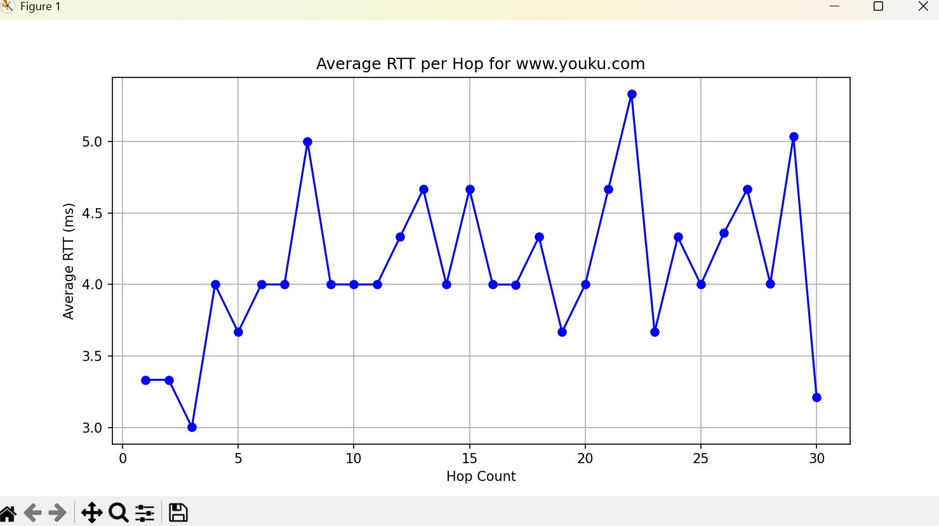
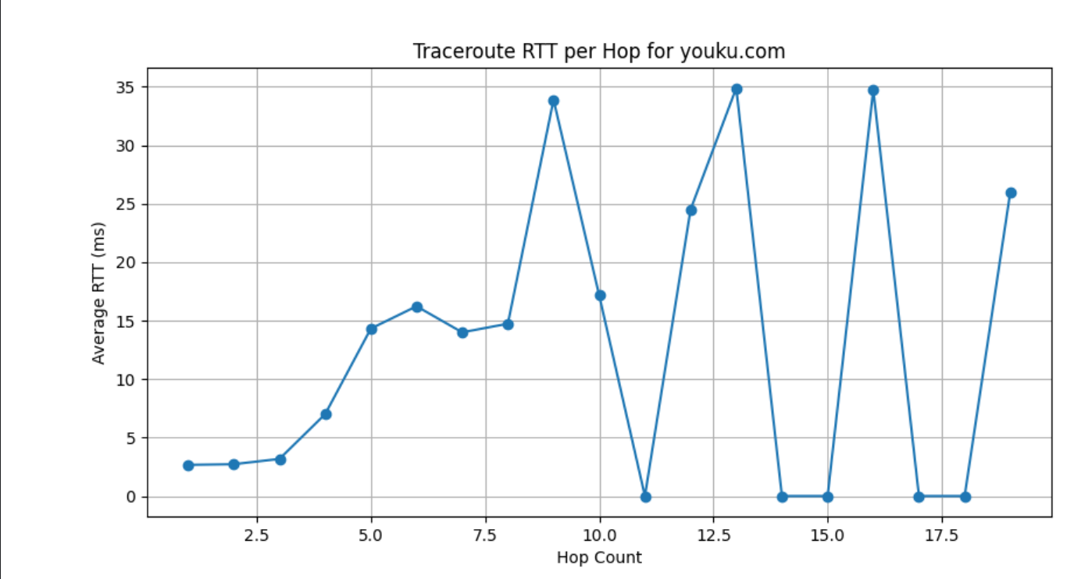
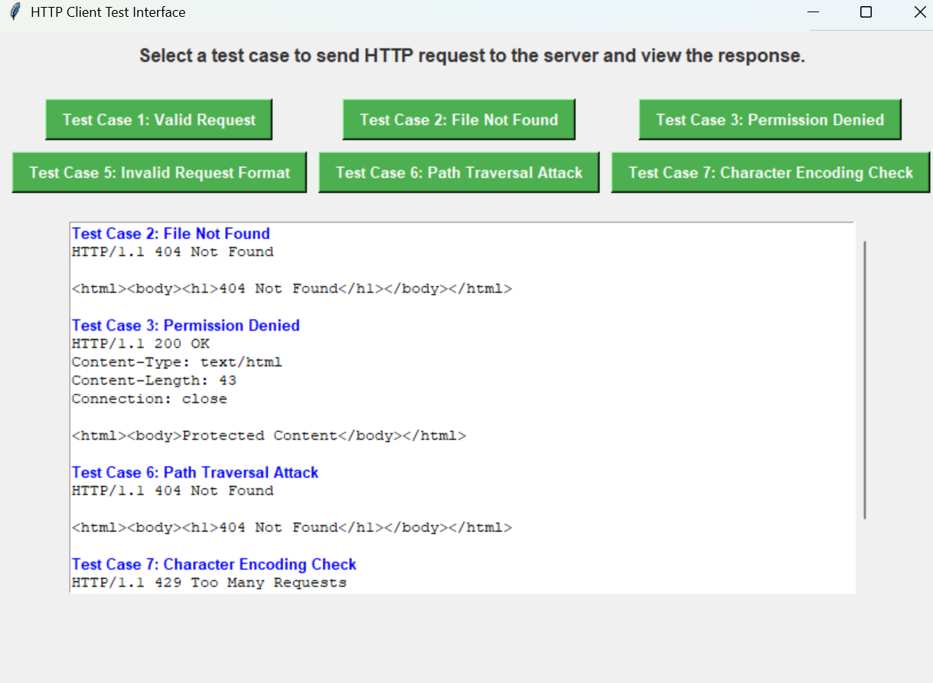




prepare
client
server
test
conclusion

Slide 35
Thank you!
Huang Hao, Zhou Yitong, Meng Yu, Chen Zijie, Wen Tianshu
2024.11.29

